Slide 1



F
I
R
S
T
C
O
R
N
A
N
I
T
H
I
S
9
.
-
18
1
A free CD of this message will be available following the service
It will also be available for podcast later this week at calvaryokc.com

Slide 2

The perfect pastor preaches exactly 20 minutes.
soundly condemns
sin but never hurts anyone's feelings.
works from 8 AM
until midnight and is also the church janitor.
O
A
N
S
9:1-18
I
I
F
I
R
S
T
C
R
N
T
H

Slide 3
He makes $40 a week, wears good clothes, drives a good car,
Buys good books,
And donates $30
a week to the
church.
He is 35 years old and has 40 years’ experience.
O
A
N
S
9:1-18
I
I
F
I
R
S
T
C
R
N
T
H

Slide 4
He is handsome.
smiles all the time
with a straight
face because he has
a sense of humor
that keeps him
seriously dedicated
to his church.
O
A
N
S
9:1-18
I
I
F
I
R
S
T
C
R
N
T
H

Slide 5
makes 15 home visits a day and is always in his office.
always has time
for church council
and all committees.
never misses the
meeting of any
church organization and is always busy Evangelizing the unchurched.
O
A
N
S
9:1-18
I
I
F
I
R
S
T
C
R
N
T
H

Slide 6
is always in the next church over!
O
A
N
S
9:1-18
I
I
F
I
R
S
T
C
R
N
T
H

Slide 7

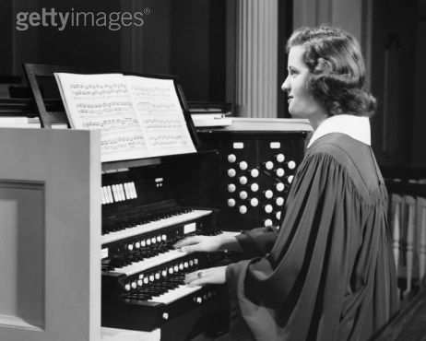

Pastor
Pastor’s wife
O
A
N
S
9:1-18
I
I
F
I
R
S
T
C
R
N
T
H

Slide 8
Success -o-Meter
5,000
Success!
$6,000,000
2,500
$3,000,000
Good
1,500
$2,000,000
Average
1,000
$1,300,000
So-so
600
$800,000
350
Not bad
$400,000
150
Room for improving
$150,000
50
$50,000
Missed his calling
Attendance
tithes
O
A
N
S
9:1-18
I
I
F
I
R
S
T
C
R
N
T
H

Slide 9
Hinder – a cutting
O
A
N
S
9:1-18
I
I
F
I
R
S
T
C
R
N
T
H

Slide 10
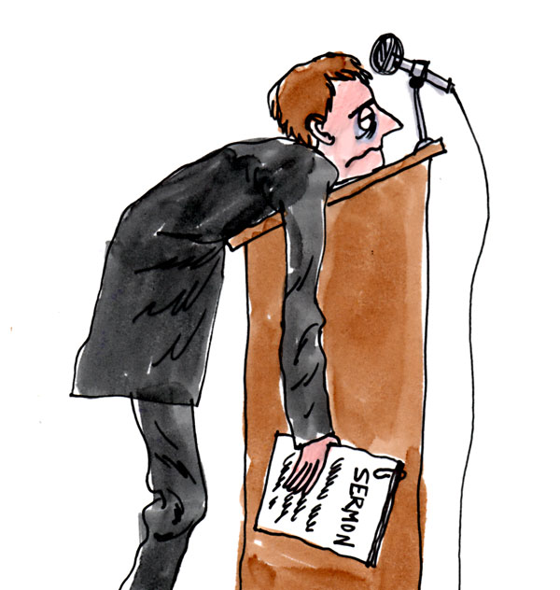
23% have been fired or pressured to resign at least once in their careers.
Source: barna.org
25% don't know where to turn when they have a family or personal conflict or issue.
O
A
N
S
9:1-18
I
I
F
I
R
S
T
C
R
N
T
H

Slide 11
45% of pastors' wives say the greatest danger to them and their family is physical, emotional, mental, and spiritual burnout.
Source: barna.org
O
A
N
S
9:1-18
I
I
F
I
R
S
T
C
R
N
T
H

Slide 12
57% would leave the pastorate if they had somewhere else to go or some other vocation they could do.
Source: barna.org
90% feel unqualified or poorly prepared for ministry.
O
A
N
S
9:1-18
I
I
F
I
R
S
T
C
R
N
T
H

Slide 13
90% work more than 50 hours a week.
Source: barna.org
94% feel under pressure to have a perfect family.
1,500 pastors leave their ministries each month due to burnout, conflict, or moral failure.
O
A
N
S
9:1-18
I
I
F
I
R
S
T
C
R
N
T
H

